Slide 1
Operating Systems Structures

Slide 2

Operating Systems Structures
A system as large and complex as a modern operating system must be engineered carefully if it is to function properly and be modified easily
Structure/Organization/Layout of OSs:
Monolithic Structure(one unstructured program)
Layered Approach
Microkernels
Hybrid systems

Slide 3
Monolithic Structure
The simplest structure for organizing an operating system is no structure at all.
That is, place all of the functionality of the kernel into a single, static binary file that runs in a single address space.
Eg: Traditional UNIX System Structure
Everything below the system-call interface and above the physical hardware is the kernel.
The kernel provides the file system, CPU scheduling, memory management, and other operating system functions through system calls.
Taken in sum, that is an enormous amount of functionality to be combined into one single address space.

Slide 4
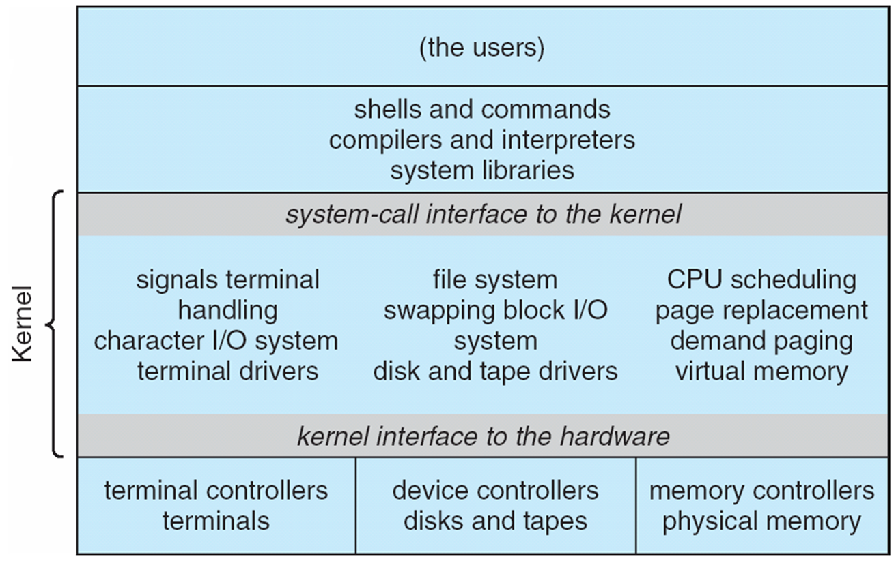
Traditional UNIX System Structure

Slide 5
Traditional UNIX System Structure
UNIX – limited by hardware functionality, the original UNIX OS had limited structuring.
The UNIX OS consists of two separable parts:
Systems Programs:
The Kernel:
Consists of everything below the system-call interface and above the physical hardware.
Provides the file system, CPU scheduling, memory management, and other operating-system functions; a large number of functions for one level.

Slide 6
Linux system structure
The Linux operating system is based on UNIX and is structured similarly, as shown in below Figure.
Applications typically use the glibc standard C library when communicating with the system call interface to the kernel.
The Linux kernel is monolithic in that it runs entirely in kernel mode in a single address space, but as we shall see later that, it does have a modular design that allows the kernel to be modified during run time.

Slide 7
Linux system structure

Slide 8
Monolithic Structure
Despite the apparent simplicity of monolithic kernels, they are difficult to implement and extend.
Despite the drawbacks of monolithic kernels, their speed and efficiency explains why we still see evidence of this structure in the UNIX, Linux, and Windows operating systems.

Slide 9
Layered Approach
The monolithic approach is often known as a tightly coupled system because changes to one part of the system can have wide-ranging effects on other parts.
Alternatively, we could design a loosely coupled system.
Such a system is divided into separate, smaller components that have specific and limited functionality.
All these components together comprise the kernel.
The advantage of this modular approach is that changes in one component affect only that component, and no others, allowing system implementers more freedom in creating and changing the inner workings of the system.

Slide 10
Layered Approach
The operating system is divided into a number of layers (levels), each built on top of lower layers.
The bottom layer (layer 0) is the hardware; the highest (layer N) is the user interface.
With modularity, layers are selected such that each uses functions (operations) and services of only lower-level layers.
Hence, each layer hides the existence of certain data structures, operations, and hardware from higher-level layers.

Slide 11
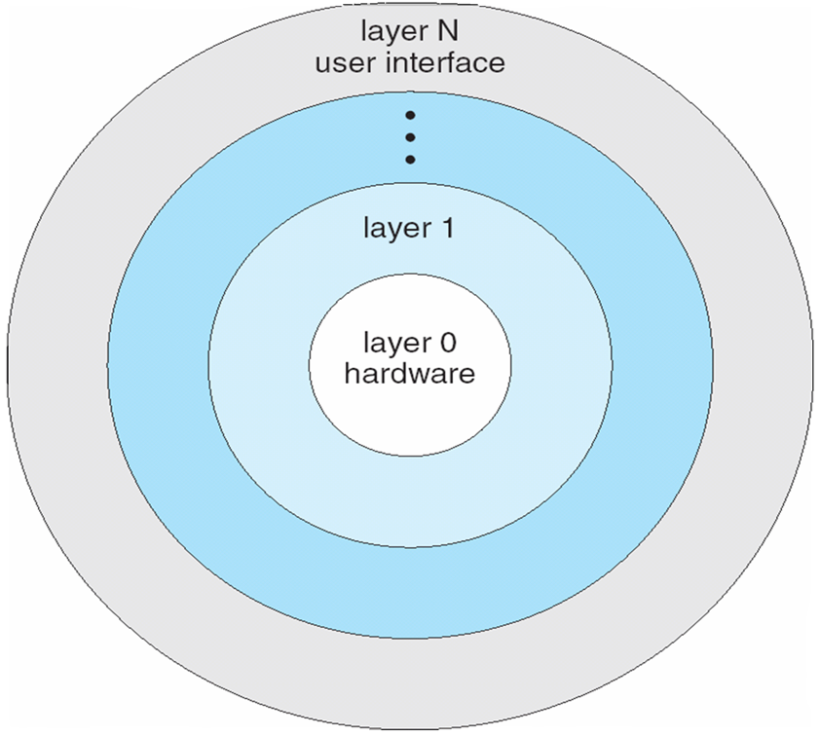
Layered Operating System

Slide 12
Layered Approach
Relatively few operating systems use a pure layered approach.
One reason involves the challenges of appropriately defining the functionality of each layer.
In addition, the overall performance of such systems is poor due to the overhead of requiring a user program to traverse through multiple layers to obtain an operating-system service.
Generally, these systems have fewer layers with more functionality, providing most of the advantages of modularized code while avoiding the problems of layer definition and interaction.

Slide 13
Microkernel System Structure
We have already seen that the original UNIX system had a monolithic structure.
As UNIX expanded, the kernel became large and difficult to manage.
In the mid-1980s, researchers at Carnegie Mellon University developed an operating system called Mach that modularized the kernel using the microkernel approach.
This method structures the operating system by removing all nonessential components from the kernel and implementing them as user-level programs that reside in separate address spaces.

Slide 14
Microkernel System Structure
Move as much functionality as possible from the kernel into “user” space.
Only a few essential functions in the kernel:
primitive memory management (address space)
I/O and interrupt management
Inter-Process Communication (IPC)
basic scheduling
Other OS services are provided by processes running in user mode (vertical servers):
device drivers, file system, virtual memory…

Slide 15
Architecture of a typical microkernel

Slide 16
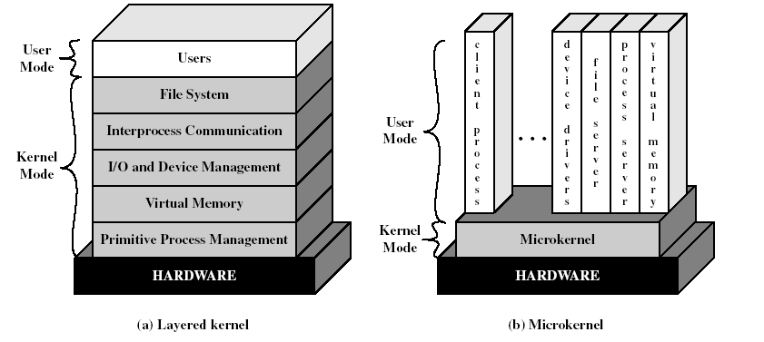
Layered vs. Microkernel Architecture

Slide 17


Microkernel System Structure
Communication takes place between user modules using message passing.
More flexibility, extensibility, portability and reliability.
But performance overhead caused by replacing service calls with message exchanges between processes.

Slide 18
Benefits of a Microkernel Organization
Extensibility/Reliability
easier to extend a microkernel
easier to port the operating system to new architectures
more reliable (less code is running in kernel mode)
more secure
small microkernel can be rigorously tested.
Portability
changes needed to port the system to a new processor is done in the microkernel, not in the other services.

Slide 19
Benefits of Microkernel Organization
Distributed system support
message are sent without knowing what the target machine is.
Object-oriented operating system
components are objects with clearly defined interfaces that can be interconnected to form software.

Slide 20
Disadvantages of Microkernel Structure
Unfortunately, the performance of microkernels can suffer due to increased system-function overhead.
When two user-level services must communicate, messages must be copied between the services, which reside in separate address spaces.
In addition, the operating system may have to switch from one process to the next to exchange the messages.
The overhead involved in copying messages and switching between processes has been the largest impediment to the growth of microkernel-based operating systems.

Slide 21
Modules
The best current methodology for operating-system design involves using loadable kernel modules (LKMs).
Here, the kernel has a set of core components and can link in additional services via modules, either at boot time or during run time.
This type of design is common in modern implementations of UNIX, such as Linux, macOS, and Solaris, as well as Windows.
The idea of the design is for the kernel to provide core services, while other services are implemented dynamically, as the kernel is running.

Slide 22
Modules
Linking services dynamically is preferable to adding new features directly to the kernel, which would require recompiling the kernel every time a change was made.
Thus, for example, we might build CPU scheduling and memory management algorithms directly into the kernel and then add support for different file systems by way of loadable modules.
The overall result resembles a layered system in that each kernel section has defined, protected interfaces; but it is more flexible than a layered system, because any module can call any other module.

Slide 23
Modules
The approach is also similar to the microkernel approach in that the primary module has only core functions and knowledge of how to load and communicate with other modules; but it is more efficient, because modules do not need to invoke message passing in order to communicate.
Linux uses loadable kernel modules, primarily for supporting device drivers and file systems.
LKMs can be “inserted” into the kernel as the system is started (or booted) or during run time, such as when a USB device is plugged into a running machine.
If the Linux kernel does not have the necessary driver, it can be dynamically loaded.
LKMs can be removed from the kernel during run time as well.
For Linux, LKMs allow a dynamic and modular kernel, while maintaining the performance benefits of a monolithic system.

Slide 24
Hybrid Systems
In practice, very few operating systems adopt a single, strictly defined structure.
Instead, they combine different structures, resulting in hybrid systems that address performance, security, and usability issues.
For example, Linux is monolithic, because having the operating system in a single address space provides very efficient performance.
However, it also modular, so that new functionality can be dynamically added to the kernel.

Slide 25
Hybrid Systems
Windows is largely monolithic as well (again primarily for performance reasons), but it retains some behavior typical of microkernel systems, including providing support for separate subsystems (known as operating-system personalities) that run as user-mode processes.
Windows systems also provide support for dynamically loadable kernel modules.

